Slide 1
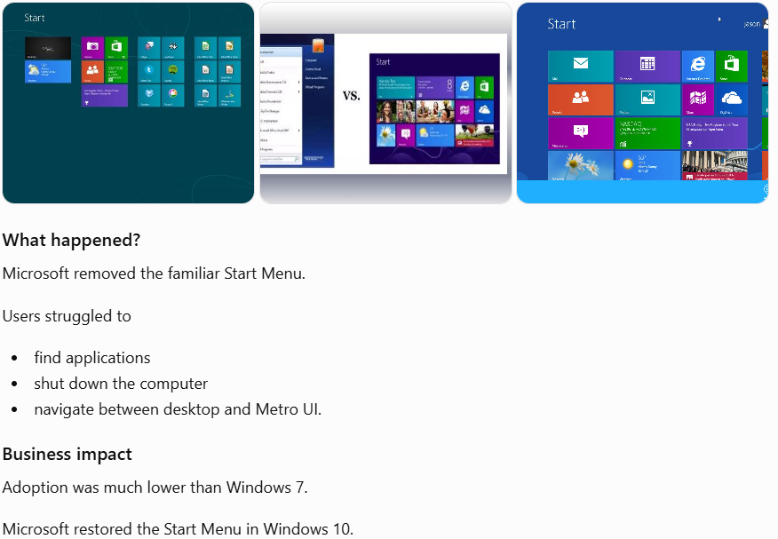

Slide 2
Is this a software bug or an HCI problem
???

Slide 3



chapter 6
HCI in the software process

Slide 4
HCI in the software process
Software engineering and the design process for interactive systems
Usability engineering
Iterative design and prototyping
Design rationale

Slide 5
the software lifecycle
Software engineering is the discipline for understanding the software design process, or life cycle
Designing for usability occurs at all stages of the life cycle, not as a single isolated activity

Slide 6
Expectation From a Food Delivery App
???

Slide 7
The waterfall model
Requirements
specification
Architectural
design
Detailed
design
Coding and
unit testing
Integration
and testing
Operation and
maintenance

Slide 8
Stage | What Developers Think | What Users Think
Requirements | Everything is clear | Nobody asked me
Design | Looks beautiful | Can't use it
Coding | Works perfectly | Doesn't solve my problem
Testing | No bugs | Very frustrating
Software can be bug-free but still unusable !!!!

Slide 9
Usability engineering
The ultimate test of usability based on measurement of user experience
Usability engineering demands that specific usability measures be made explicit as requirements
Usability specification
  usability attribute/principle
  measuring concept
  measuring method
  now level/ worst case/ planned level/ best case
Problems
  usability specification requires level of detail that may not be
  possible early in design satisfying a usability specification
  does not necessarily satisfy usability

Slide 10
The life cycle for interactive systems
cannot assume a linear
sequence of activities
as in the waterfall model
lots of feedback!
Requirements
specification
Architectural
design
Detailed
design
Coding and
unit testing
Integration
and testing
Operation and
maintenance

Slide 11
ISO usability standard 9241
adopts traditional usability categories:
effectiveness
  can you achieve what you want to?
efficiency
  can you do it without wasting effort?
satisfaction
  do you enjoy the process?

Slide 12
Usability Evaluation
???
ChatGPT vs Gemini

Slide 13
Verification and validation
Verification
  designing the product right
Validation
  designing the right product
The formality gap
  validation will always rely to some extent on subjective means of proof
Management and contractual issues
  design in commercial and legal contexts
Real-world
requirements
and constraints
The formality gap

Slide 14
A hospital software perfectly follows the SRS.
Doctors refuse to use it.
Question: Is this
A. Verification problem
B. Validation problem

Slide 15
Iterative design and prototyping
Iterative design overcomes inherent problems of incomplete requirements
Prototypes
  simulate or animate some features of intended system
  different types of prototypes
    throw-away
    incremental
    evolutionary
Management issues
  time
  planning
  non-functional features
  contracts

Slide 16
Iterative design and prototyping
Different types of prototyping
Throw-away- The prototype is built and tested. The design knowledge gained from this exercise is used to build the final product, but the actual prototype is discarded.
Incremental- The final product is built as separate components, one at a time. There is one overall design for the final system. The final product is then released as a series of products, each subsequent release including one more component.
Evolutionary - Here the prototype is not discarded and serves as the basis for the next iteration of design. In this case, the actual system is seen as evolving from a very limited initial version to its final release

Slide 17
Iterative design and prototyping
Type | What Happens? | Real Example
Throw-away | Build a prototype only to gather feedback, then discard it and develop the real system from scratch. | A paper mock-up of a Food Delivery App is tested with users, then discarded before actual coding begins.
Incremental | The final system is planned from the beginning, but developed and released one feature (module) at a time. | Version 1 has Login, Version 2 adds Food Ordering, Version 3 adds Payment, Version 4 adds Live Tracking.
Evolutionary | Start with a simple working prototype and continuously improve the same system based on user feedback until it becomes the final product. | A basic Food Delivery App with only food ordering is released. Based on user feedback, the same application gradually gains payment, tracking, ratings, AI recommendations, etc.

Slide 18
Iterative design and prototyping
Idea
↓
Prototype
↓
User Feedback
↓
Discard Prototype ❌
↓
Develop Final System from Scratch
Throw-away Prototype
Final Design Planned
Version 1
(Login)
↓
Version 2
(+ Ordering)
↓
Version 3
(+ Payment)
↓
Version 4
(+ Tracking)
↓
Complete System
Simple Prototype
↓
Improve Based on Feedback
↓
Improve Again
↓
Improve Again
↓
Final System
Incremental Prototype
Evolutionary Prototype

Slide 19
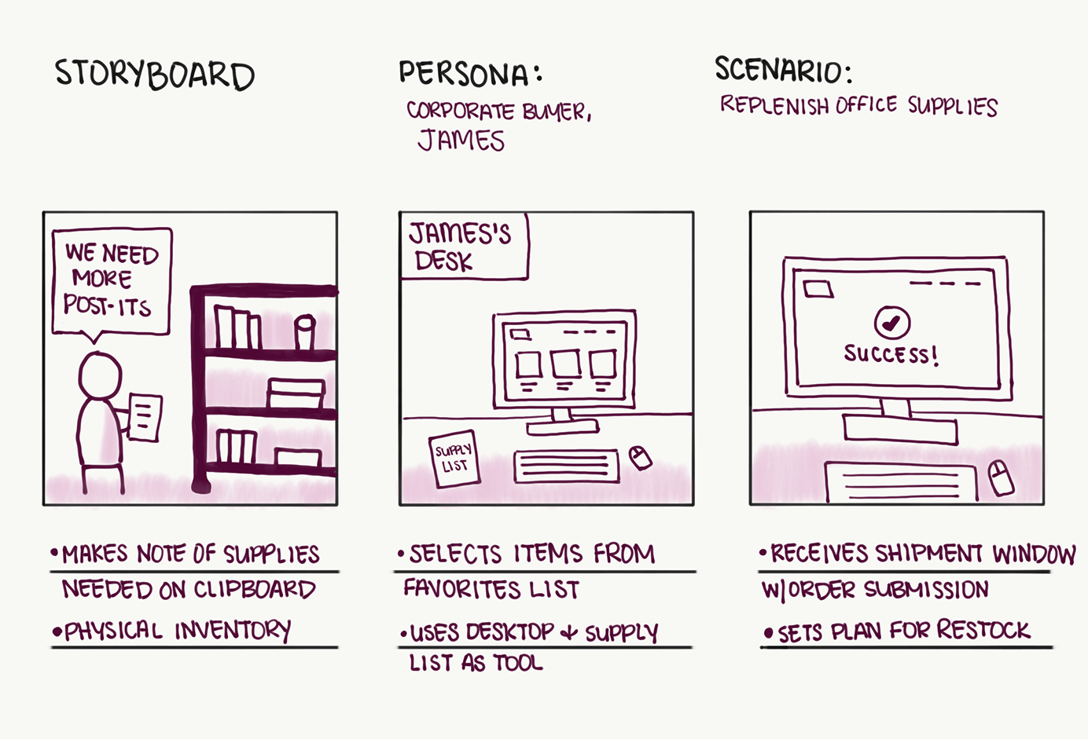
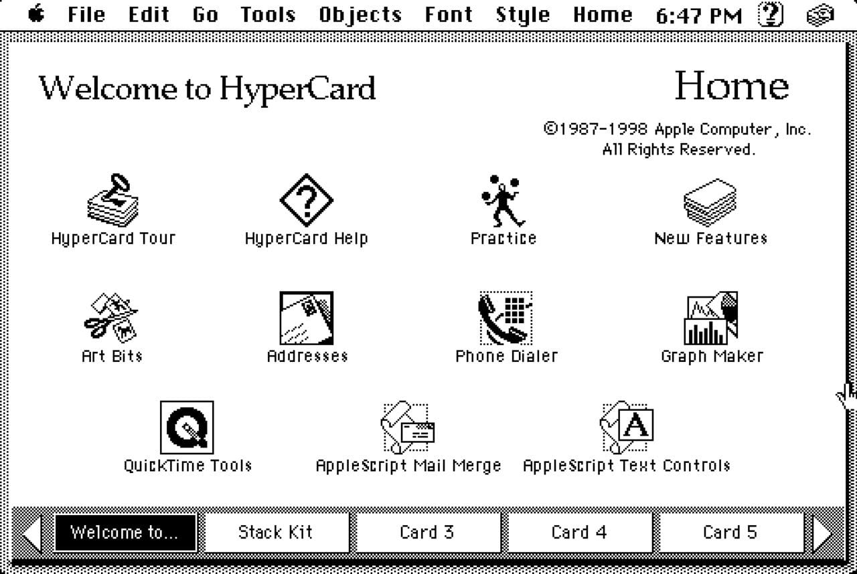

Iterative design and prototyping
What are techniques used for prototyping?
Storyboards -need not be computer-based
Limited functionality simulations - some part of system functionality provided by designers tools like HyperCard are common for these Wizard of Oz technique can be animated
Card Sorting

Slide 20
Iterative design and prototyping
Advantages and disadvantages of Prototyping Model
Advantages:
    It produces the products quickly and thus saves the time and solves the waiting problem in waterfall model.
    It minimizes the cost and product failure.
    It is possible for the developers and client to check the function of preliminary implementations of system models before committing to a final system.
    It obtains feedback from clients and changes in system concept
Disadvantages:
    It ignores quality, reliability maintainability and safety requirements.
    Customer satisfaction is not achieved.

Slide 21
Design rationale
Design rationale is information that explains why a computer system is the way it is.
Benefits of design rationale
  communication throughout life cycle
  reuse of design knowledge across products
  enforces design discipline
  presents arguments for design trade-offs
  organizes potentially large design space
  capturing contextual information

Slide 22
Design rationale (cont’d)
Types of DR:
Process-oriented
  preserves order of deliberation and decision-making
Structure-oriented
  emphasizes post hoc structuring of considered design alternatives

Slide 23
Design rationale (cont’d)
Suppose our team is designing a University Learning Management System (LMS).
One design question is:
“How should students log in?”
Possible options:
        Google Login
        Student ID + Password
        Biometric Login
Now let’s see how the two approaches differ.

Slide 24
Process-oriented:
Issue-based information system (IBIS)
Suppose the team meeting went like this:
Issue
How should students log in?
↓
Position 1
Use Student ID and Password.
↓
Argument
Simple and already familiar.
↓
Position 2
Use Google Login.
↓
Argument
Easier for students.
↓
Counterargument
Some students do not have Google accounts.
↓
Final Decision
Student ID + Password
Final Decision
Student ID + Password
Notice that we preserve every discussion.
This is exactly what IBIS (Issue-Based Information System) does.
Why is it called Process-Oriented?
Because it records the process of thinking.
It answers:
    What issue was raised?
    What alternatives were proposed?
    Who argued for what?
    Why was one option rejected?
    How did the team finally decide?

Slide 25
Structure-oriented:
Design Space Analysis through QOC (Question Option Criteria)
Question
How should students log in?
Options
  Student ID + Password
  Google Login
  Face Recognition
Criteria
  Security
  Ease of Use
  Cost
  Implementation Time
Option | Security | Easy to Use | Cost
Student ID | High | Medium | Low
Google | Medium | High | Very Low
Face Recognition | Very High | High | High

Slide 26
Design rationale (cont’d)
Comparison Table
Process-Oriented | Structure-Oriented
Records the decision-making process | Organizes the final design alternatives
Keeps the sequence of discussions | Ignores the sequence of discussions
Focuses on arguments and debates | Focuses on comparing options
Answers "How did we decide?" | Answers "Which option is best?"
Example: IBIS | Example: QOC (Design Space Analysis)

Slide 27
Psychological Design Rationale
Psychological Design Rationale is a design approach that focuses on understanding how users think and behave while using a system, and then improving the design based on those observations.
Identify User Task
↓
Create a Usage Scenario
↓
Observe Users
↓
Understand Why Users Behave That Way
↓
Improve the Design
↓
Test Again

Slide 28
THANK YOU

